Slide 1
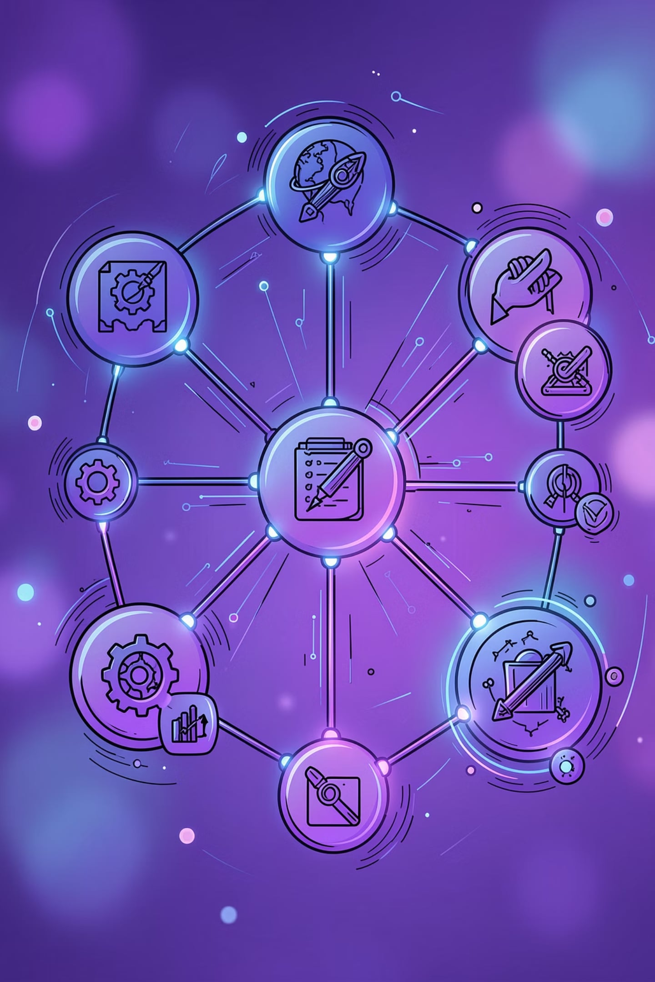
SkillBridge AI
AI-Powered Career Roadmap Generator
Supporting UN SDG 8 — Decent Work & Economic Growth
Presented by: Tanvi Mahabal

Slide 2

Problem Statement
Lack of guidance
Unclear skills
No roadmap
Students lack personalized career advice
Hard to identify required technical skills
Learning paths are fragmented and vague
Preparation gap
Career delay
Poor interview and project readiness
Delayed growth → reduced employability

Slide 3
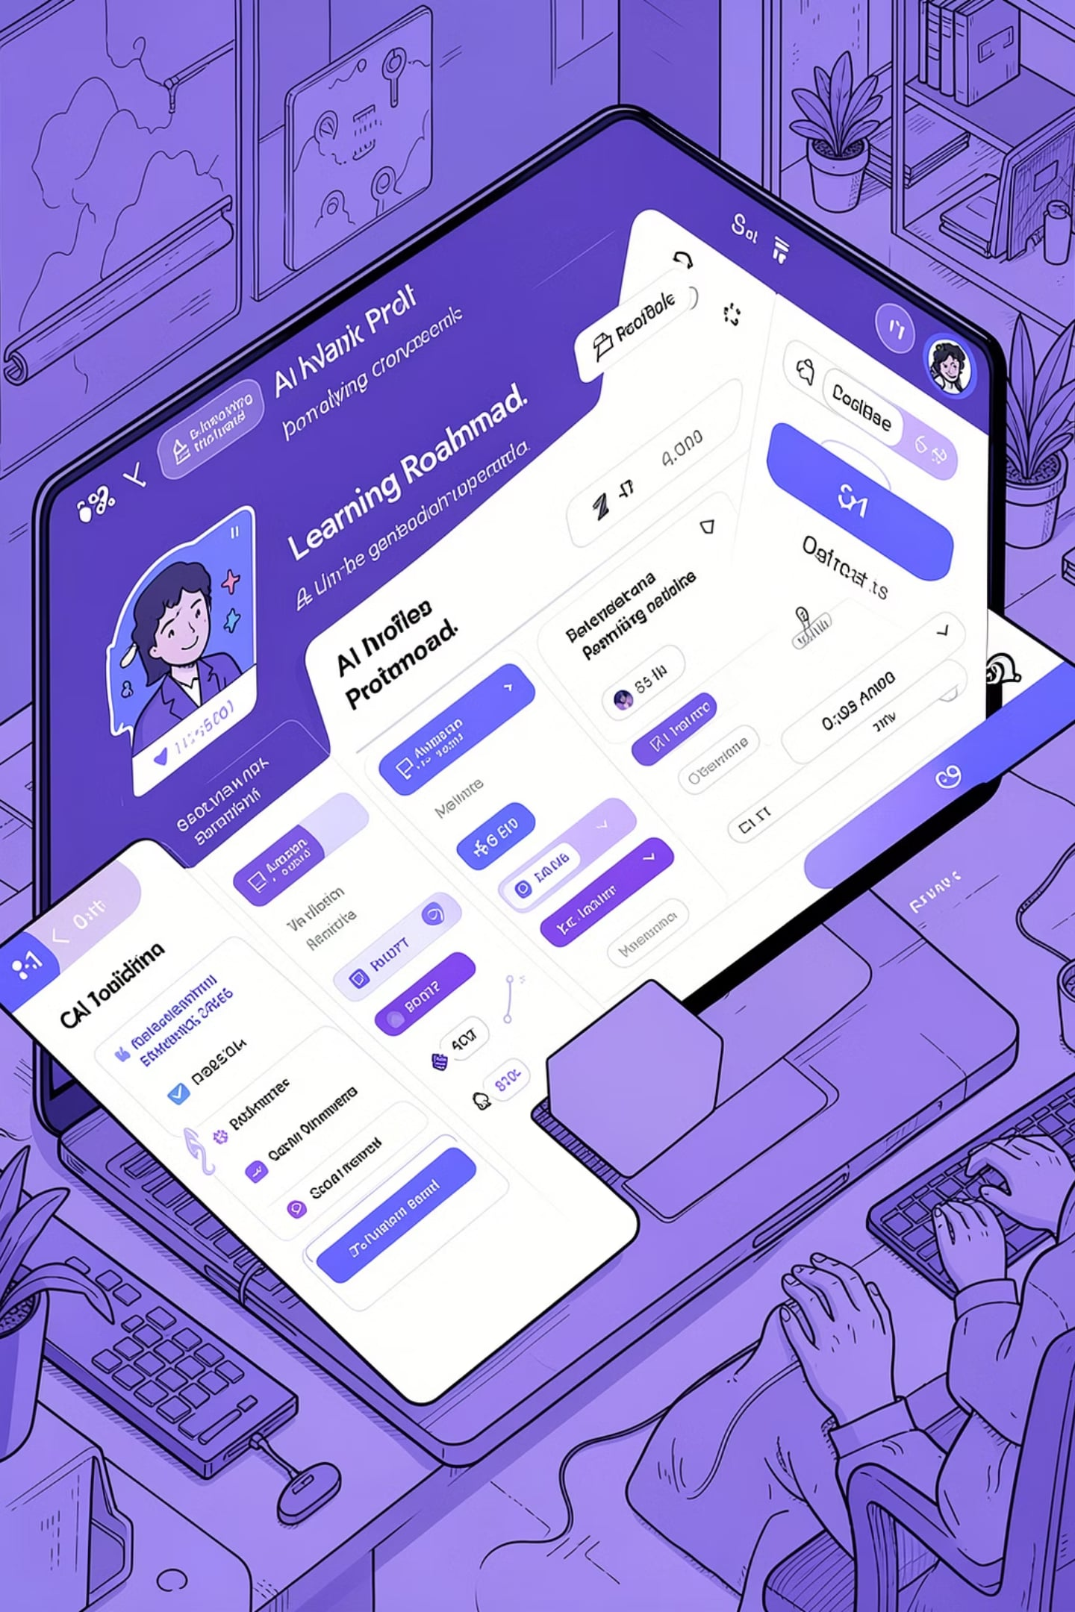
Solution & Objectives
SkillBridge AI — web app using Google Gemini to analyze goals, skills, and education
Objectives
Personalize guidance • Identify gaps • Recommend paths • Boost readiness • Support SDG 8
Personalized career analysis
Skill-gap detection
30‑day learning roadmap
Project & interview prep
Resume improvement

Slide 4
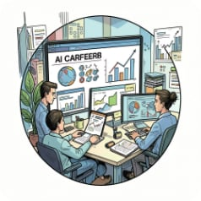
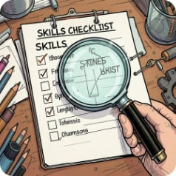



Features & Tech Stack
AI Career Analysis
Skill Gap Detection
Learning Roadmap
Project Suggestions
Profile → insights
Targeted recommendations
30‑day, weekly plans
Practical, portfolio-ready
Resume & Interview Tips
Tailored improvements
Technology
Frontend
AI & Tools
HTML, CSS, JavaScript
Responsive UI
Google Gemini API
Git, GitHub, VS Code
Backend
Python • Flask

Slide 5
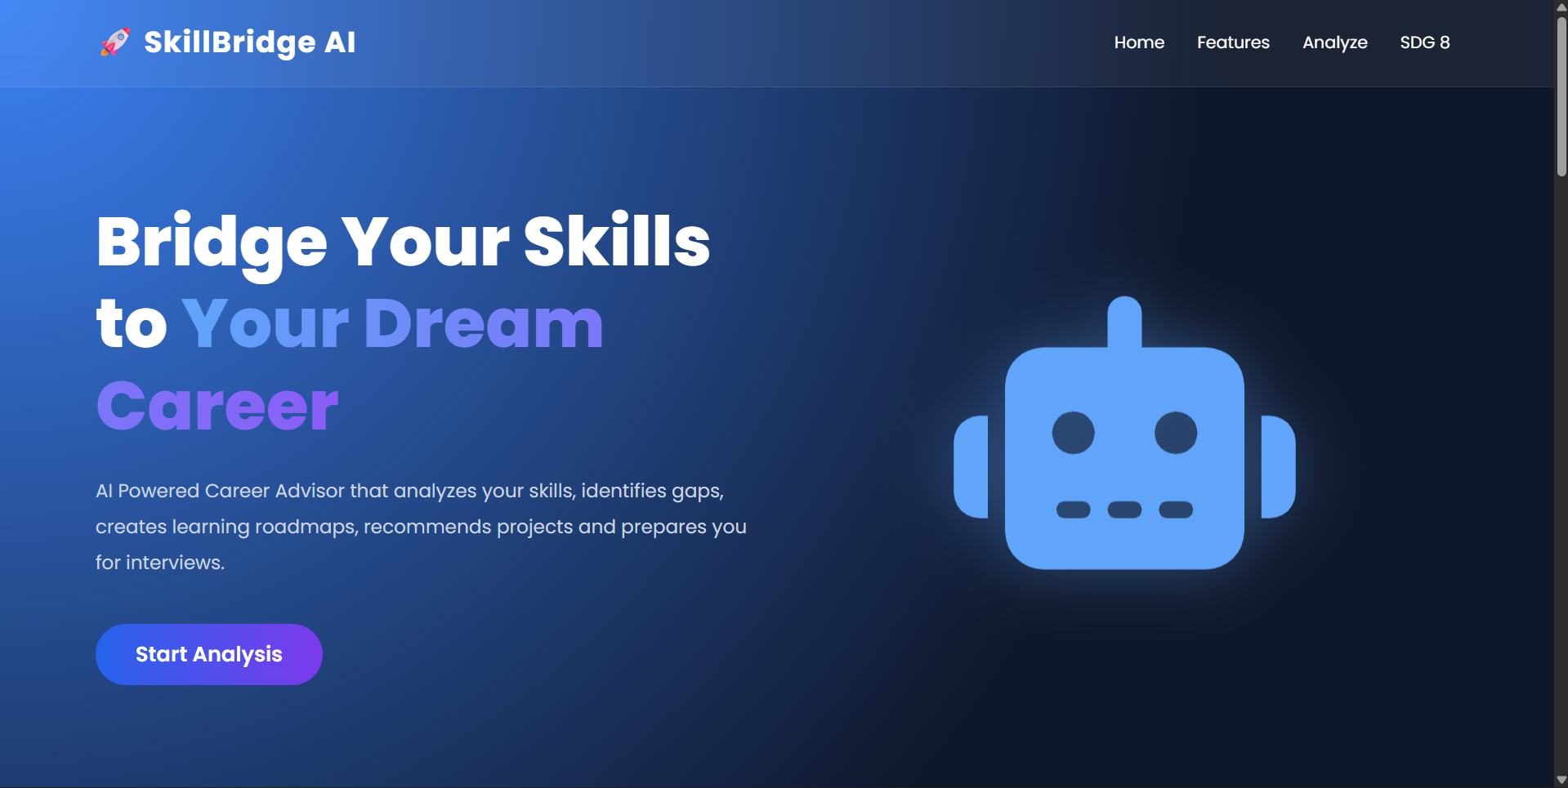
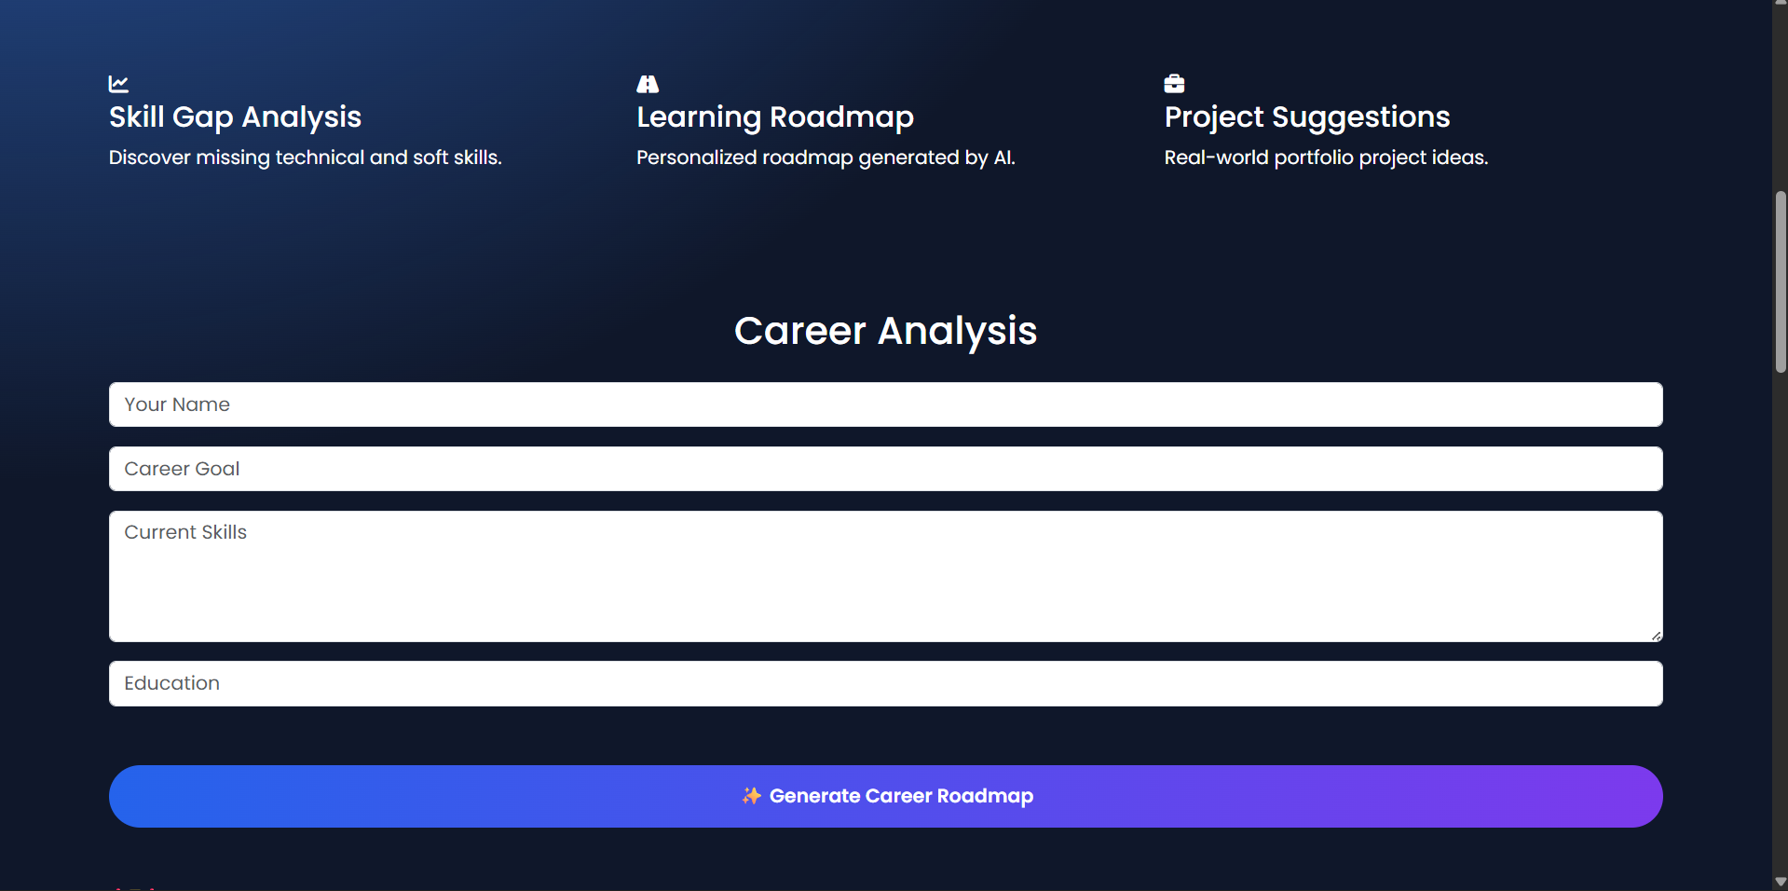
Screenshots:

Slide 6
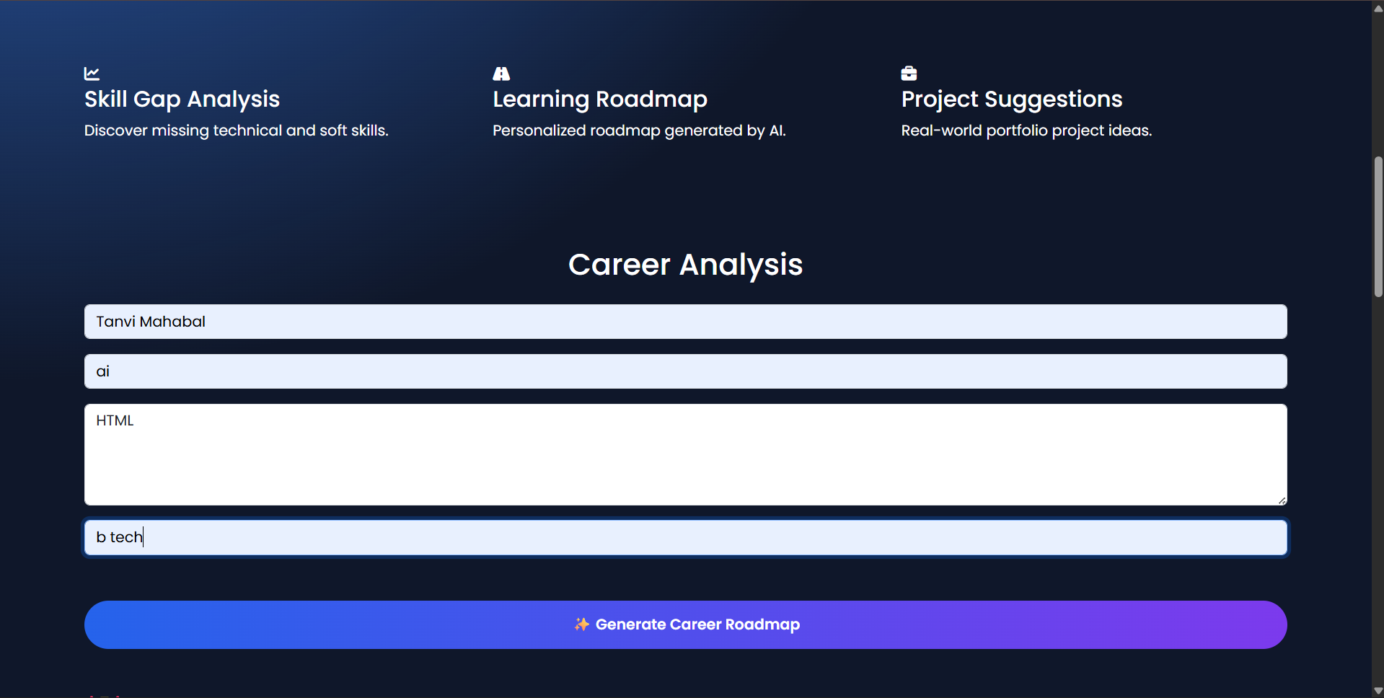
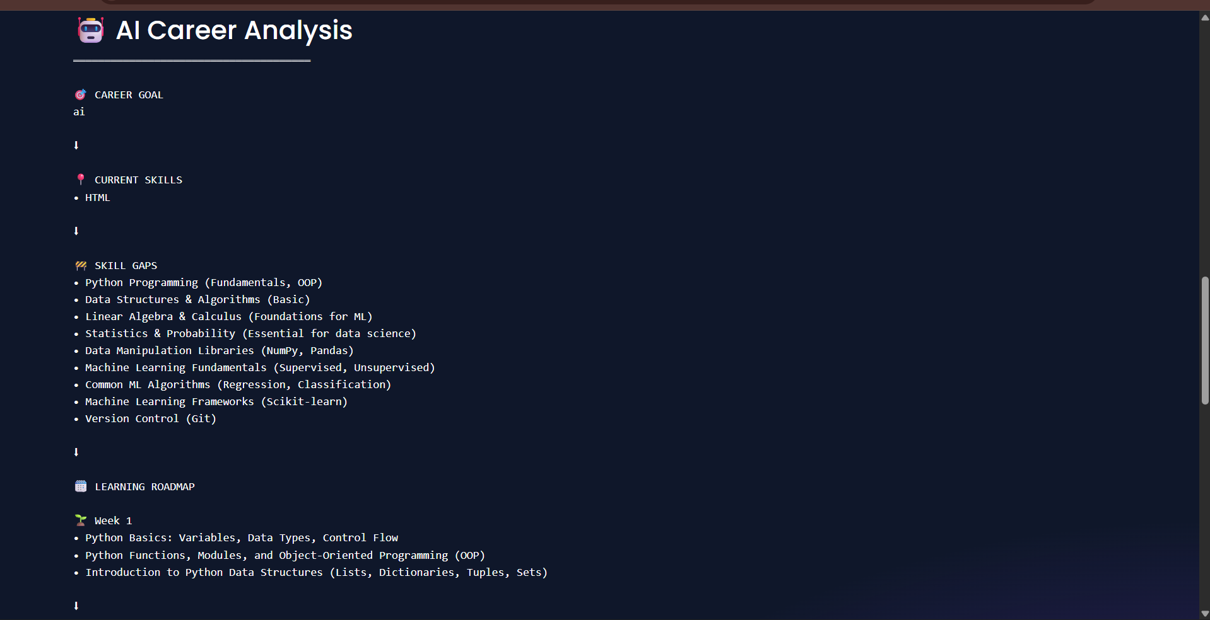
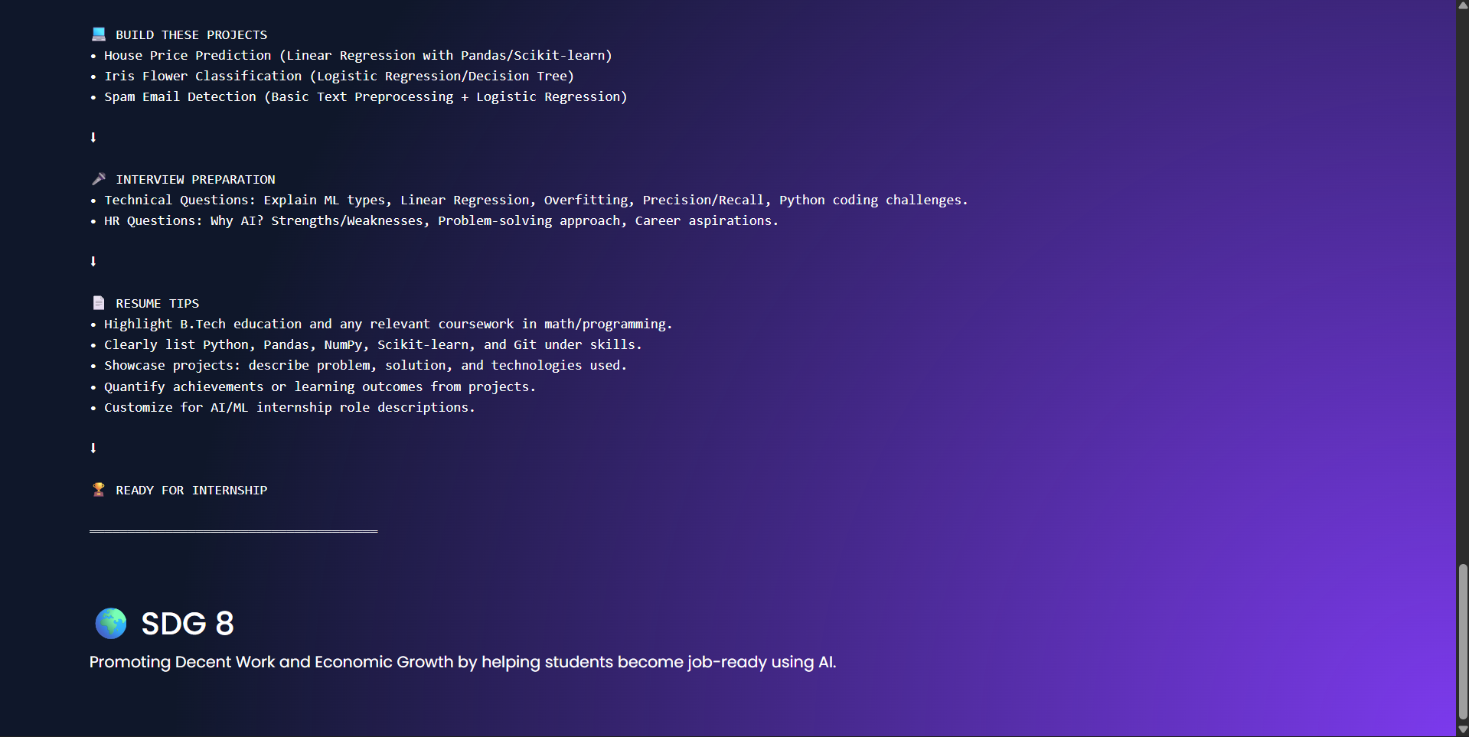

Slide 7

System Architecture & Workflow
User Input
Web Interface
Flask Backend
AI Analysis
Simple, transparent pipeline for reproducible model-driven recommendations.

Slide 8
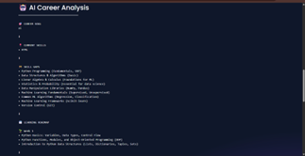

Results — Project Output
Captured Screens
Key Outputs
Home • Input form • AI roadmap
Career goal summary
Current skills & gaps
30‑day learning plan
Project & interview guidance
Resume suggestions

Slide 9
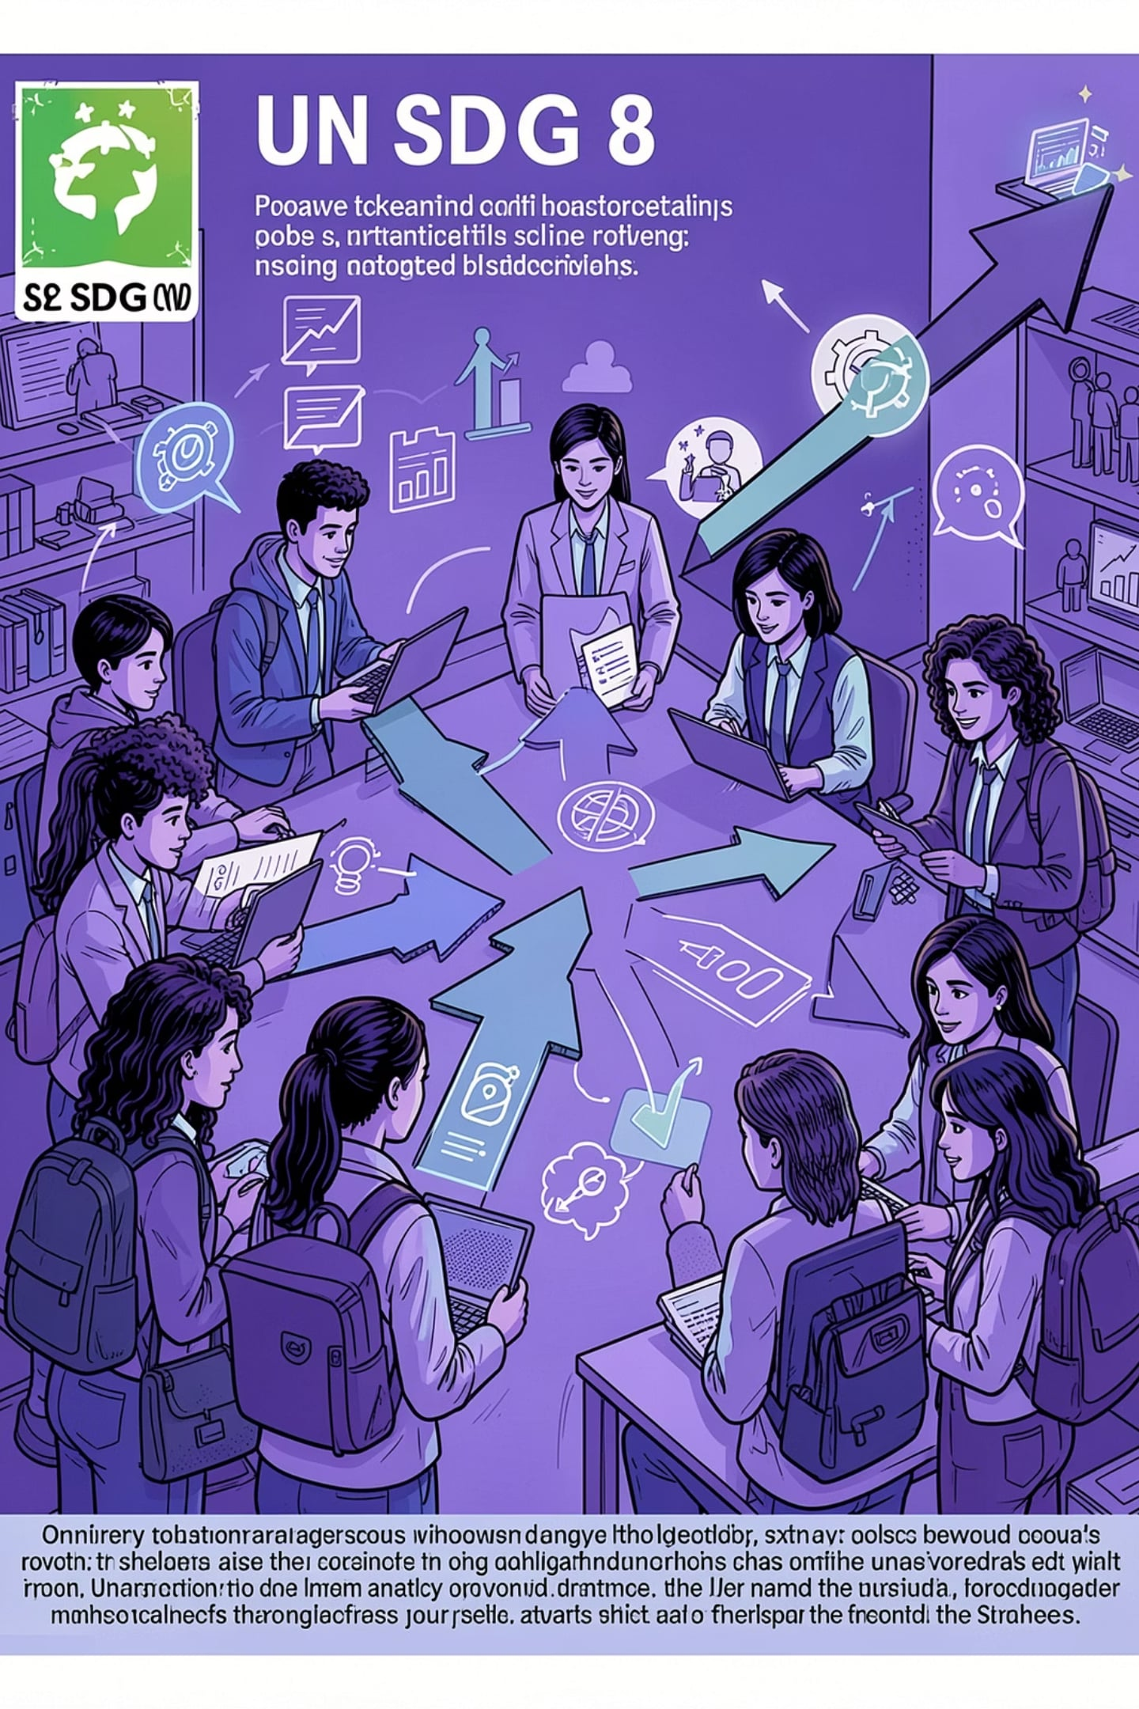
SDG 8 Impact
Skill Development
Practical, targeted upskilling
Employability
Better internship & job readiness
Informed Choices
Data-driven career decisions
Lifelong Learning
Encourages ongoing skill growth

Slide 10
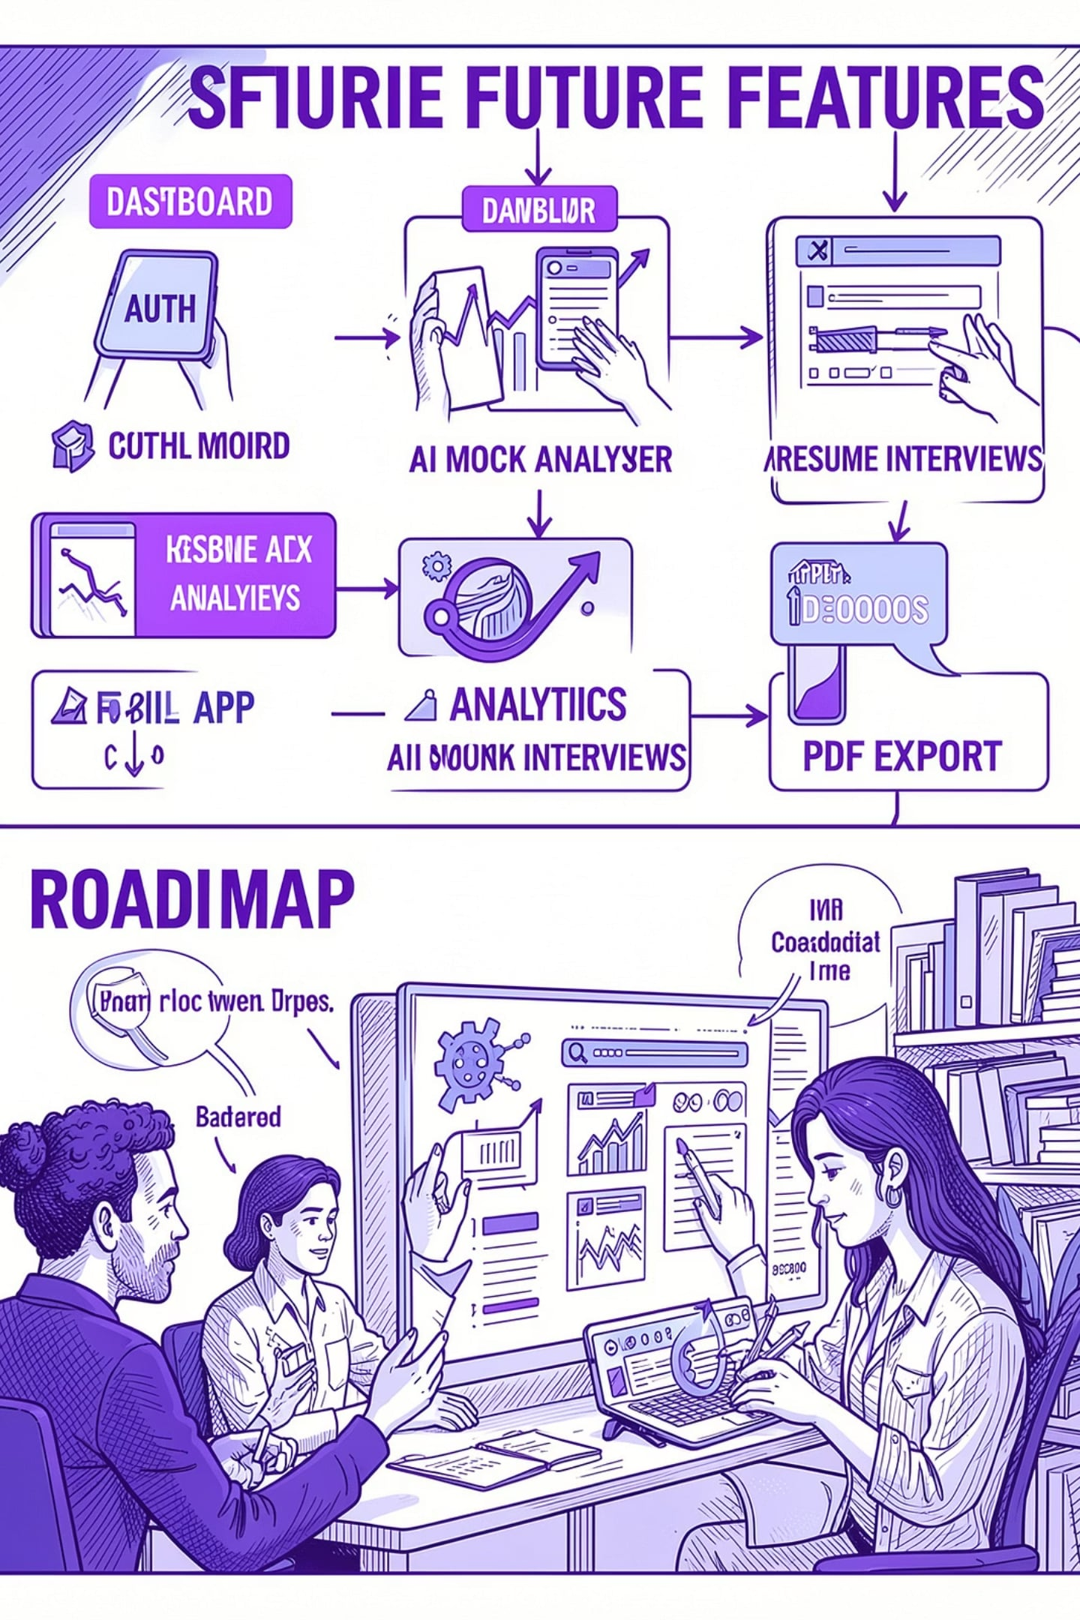
Future Scope
User authentication & profiles
Progress-tracking dashboard
Resume analyzer & PDF export
AI mock interviews
Personalized course recommendations
Mobile application
Placement analytics & employer insights
Continuous model refinement (feedback loop)

Slide 11
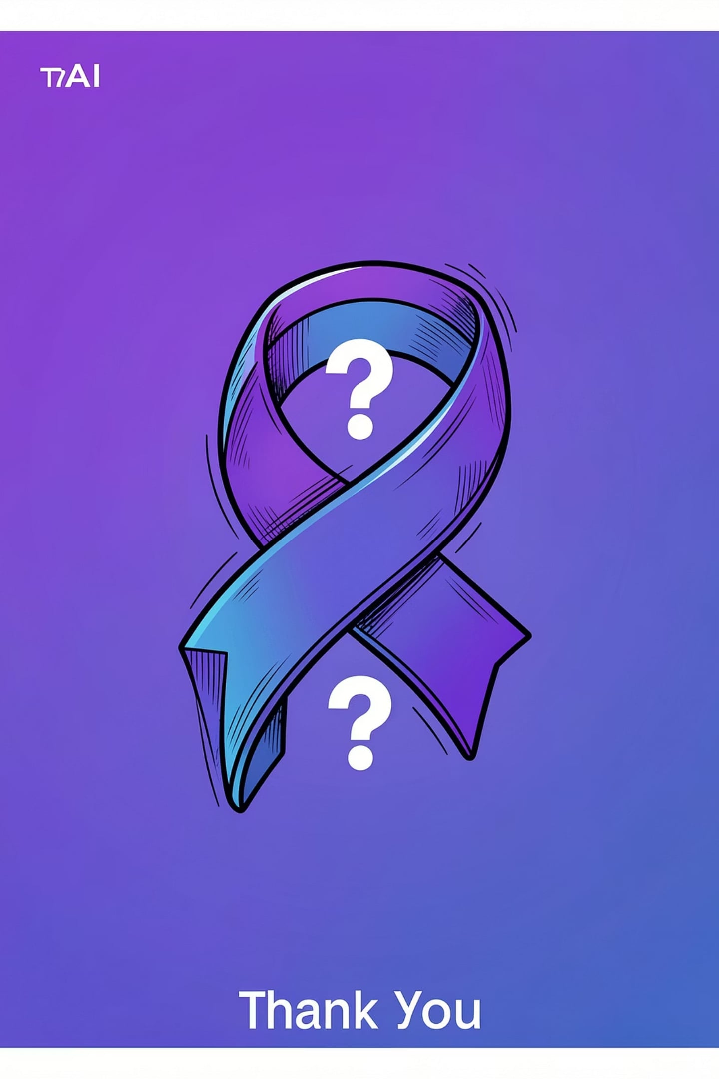
Conclusion
SkillBridge AI — personalized, practical career roadmaps that bridge education to employment and advance SDG 8.
Takeaway
Next
AI + structured plans → faster, fairer career entry
Prototype validation • user testing • scale
Thank you — Questions?

